Slide 1
User-centric comparison of input devices for digital drawing
Linfan (Linda) Xiao, Yale-NUS College
October 10, 2018

Slide 2
User-centric comparison¹ of input devices² for digital drawing³
¹Comparing different types of input devices from a user’s perspective
²Tools artists use to turn hand-drawn art into digital form
³2D drawing stored in digital form and rendered on a monitor

Slide 3
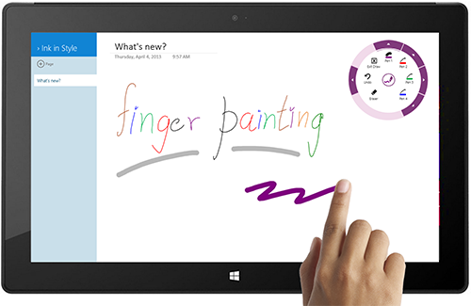
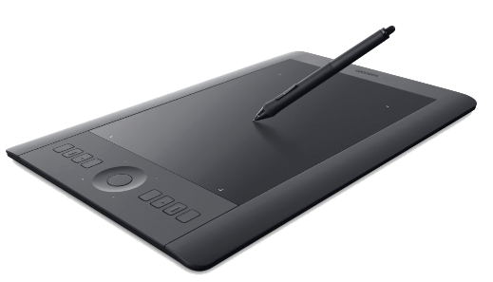
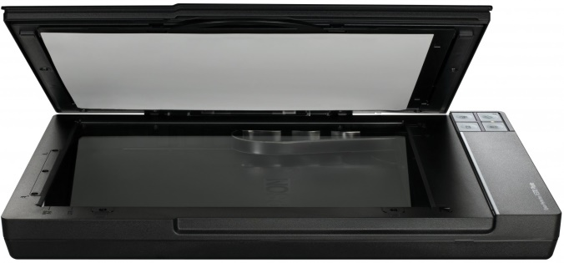
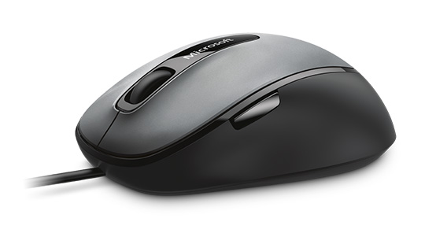
Motivation
Rise of digital art since 1960s
Need to digitize artwork produced by hand
Devices to do so
E.g., scanner, mouse, touchscreen, graphics tablet
Q: Which one, if any, is better for a digital artist?

Slide 4
Comparison: scope
What
Scanner
Mouse
Touchscreen (eye and pen both on screen)
Graphics tablet (eye on monitor, pen on tablet)
How
Faithfulness (whether it reflects traces of hand movements accurately)
Intuitiveness (whether it resembles drawing by hand)
Error tolerance (whether it allows making changes conveniently)
Portability (whether it is easy to carry)
Cost-effectiveness (whether it is economical to purchase and maintain)

Slide 5
Comparison: result
Measure / Input device | Scanner | Mouse | Touchscreen | Graphics tablet
Faithfulness | ✗ | ✓ | ✗ | ✓
Intuitiveness | ✓ | ✗ | ✗ | ✓
Error tolerance | ✗ | ✓ | ✓ | ✓
Portability | ✗ | ✓ | ✓ | ✓
Cost-effectiveness | ✗ | ✓ | ✓ | ✓
To the end of digitizing art, graphics tablet appears to be the best choice.

